Slide 1
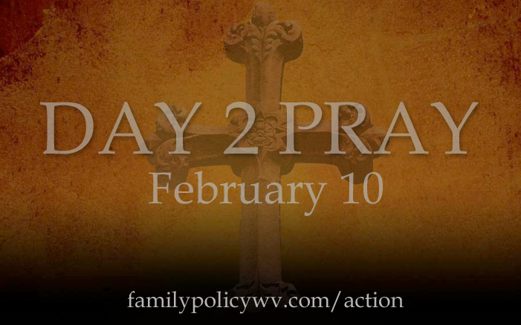
“First of all . . . pray . . .”
Pray, by name, for leaders in Washington, D.C.
Intercede for those elected in Charleston
Thank God for your politicians
www.FamilyPolicyWV.com/Day2Pray

Slide 2
“. . .seek the welfare of the city . . . pray to the Lord on its behalf . . .”
Pray for God to reveal wisdom to our leaders
Pray protection on the marriages and families of
our leaders
Thank God for the freedom to participate in
self-governance
www.FamilyPolicyWV.com/Action

