Slide 1

Part 1

Slide 2
Posers
Poser :
A poser Is someone who pretends to be something they are not.
Anyone who does not follow his/her own ideas of what he/she likes.
  A Poser
  A Fake
  A Wannabe

Slide 3
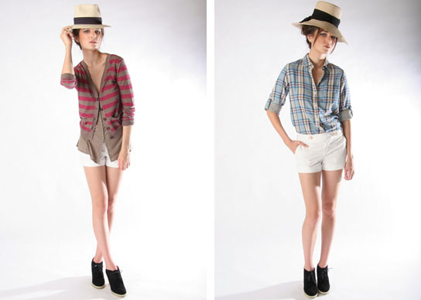
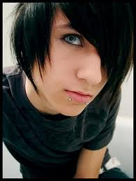
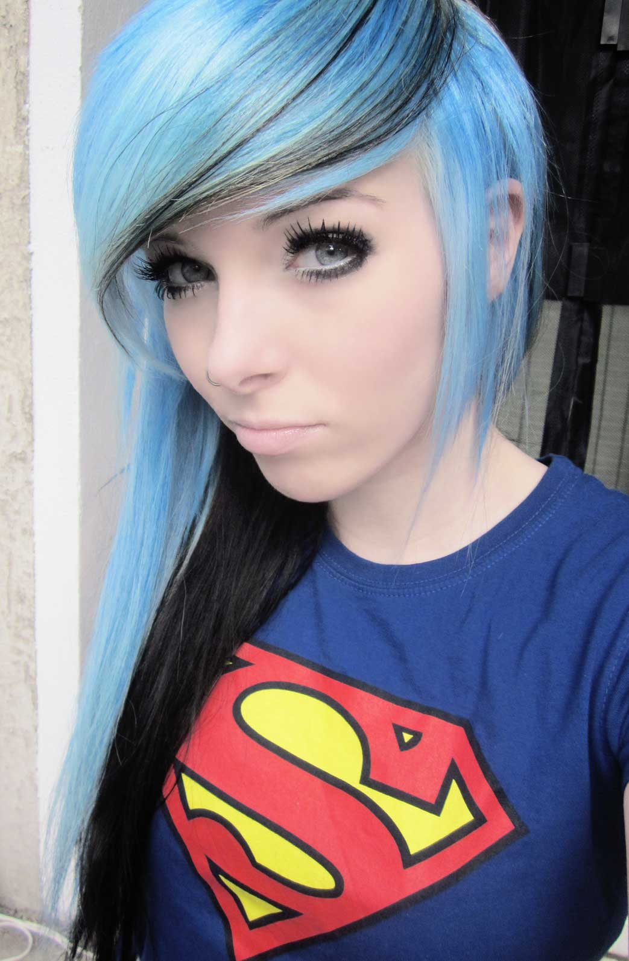


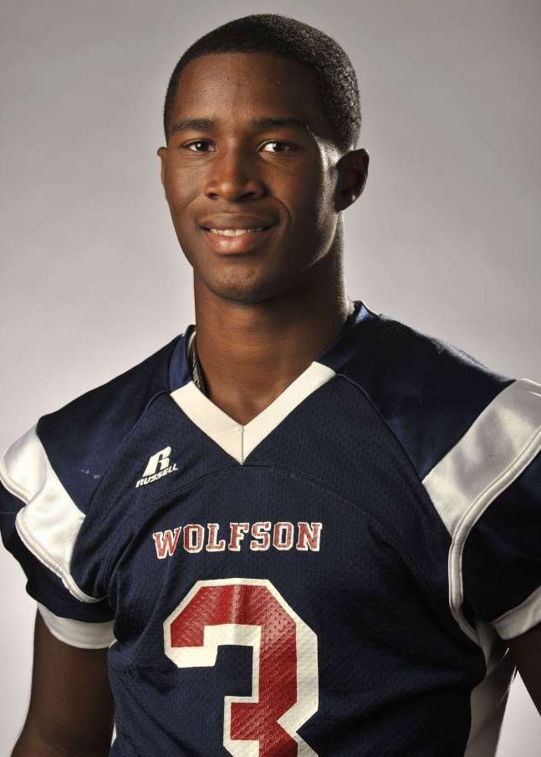
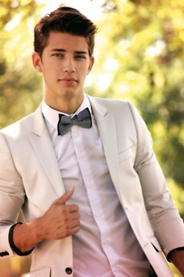
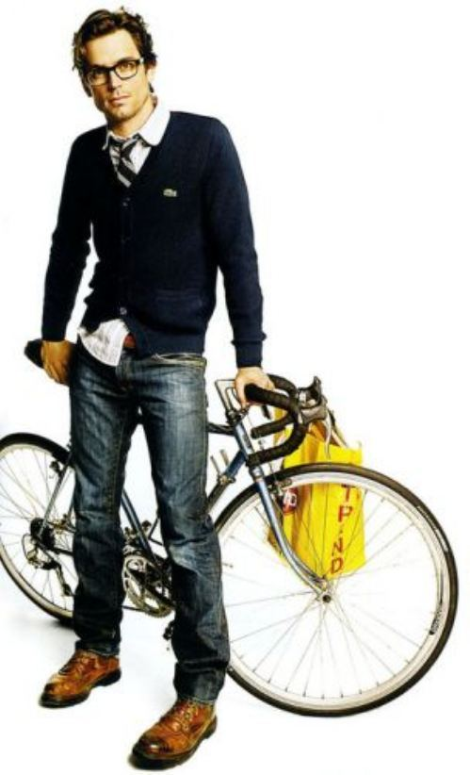


Slide 4
Posing Masks the Real YOU
At this very moment you begin LOSING yourself
You BEGIN POSING
    “Just let me be me” – we cry
    AND WE ARE NOT “ME” – AT ALL

Slide 5
Peter
A follower of Christ
Walked and talked with Jesus
Saw Jesus do miracles
  He too STRUGGLED with WHO He WAS
  He too became a POSER

Slide 6
Matthew 26:33
New Living Translation (NLT)
³³ Peter declared, “Even if everyone else deserts you, I will never desert you.”
“ Jesus, I will NEVER leave you stranded”

Slide 7
³⁴ Jesus replied, “I tell you the truth, Peter—this very night, before the rooster crows, you will deny three times that you even know me.”
³⁵ “No!” Peter insisted. “Even if I have to die with you, I will never deny you!” And all the other disciples vowed the same.
Jesus’ response to Peter was:
  In other words Peter that’s good and all to hear you say but let me tell you I know the REAL You and the Real you will be afraid.

Slide 8
⁶⁹ Meanwhile, Peter was sitting outside in the courtyard. A servant girl came over and said to him, “You were one of those with Jesus the Galilean.”
⁷⁰ But Peter denied it in front of everyone. “I don’t know what you’re talking about,” he said.
⁷¹ Later, out by the gate, another servant girl noticed him and said to those standing around, “This man was with Jesus of Nazareth.^{[l]}”
⁷² Again Peter denied it, this time with an oath. “I don’t even know the man,” he said.
⁷³ A little later some of the other bystanders came over to Peter and said, “You must be one of them; we can tell by your Galilean accent.”
⁷⁴ Peter swore, “A curse on me if I’m lying—I don’t know the man!” And immediately the rooster crowed.
⁷⁵ Suddenly, Jesus’ words flashed through Peter’s mind: “Before the rooster crows, you will deny three times that you even know me.” And he went away, weeping bitterly.

Slide 9
Peter began “posing” as someone else
  He was Insecure in who He was
  He was afraid of being mocked/ laughed at/ maybe even beaten
  He was seeking Acceptance from the people

Slide 10
“Posers” deal with 3 main issues:
  1) Insecurities :
    “Because you are insecure you have changed who you really are”
  DID You know?…
    …Most Bullies are Bullies because they have Insecurities”
    They just don’t KNOW who they REALLY are!

Slide 11
  2) Posing for Acceptance:
    You put a front on
    To make sure You Fit in
    Fake it til you Make it

Slide 12
  3) Posing out of Fear:
    The normal teenager:
      Normal For teenagers to engage in unhealthy relationships
      Normal for teenagers to be selfish
      Normal to gossip
      Normal to lie
      Normal to DATE around
      Normal to steal when you want it, if you can’t pay for it
      Normal to go to church, confess Christ and live how you want
      Who wants that?

Slide 13
  If you know who you are it changes everything about you.
“ It defines who you are not and defines everything from your character to morals and even choices you make daily. ”

