Slide 1

Bruce Raley Director of Leadership and Evangelism T&E

Slide 2
_{Name}
_{institutions, businesses,}
_{and organizations}
_{that have changed culture…}

Slide 3
Can Sunday School?

Slide 4
Five Program Church
Sunday School
Discipleship
Men’s Brotherhood
WMU
Music ministry
What’s Hot Now
Music changed
Methodologies
Seeker services
Promise keepers
Customized Church Era
Intentional
Discipleship
Process driven
Simplistic, Focused
Individualistic
50’s – 70’s
80’s – 00’s
‘04 –

Slide 5
Missional ?
What does it mean?

Slide 6
Missional...
Mission projects? Mission trips? Mission offerings?

Slide 7
Missional Sunday School
A missional Sunday School…
A reproducing community of authentic disciples being equipped as missionaries sent by God to live and proclaim His Word in their world.

Slide 8
Missional Sunday School
A missional Sunday School balances with a goal of reproducing disciples equipped to live and proclaim His Word in their world.
  Gives a clear purpose
  Strategy is based upon context of the mission field and capacity of God’s people
What is purpose of Sunday School?

Slide 9

Balance

Slide 10
Balance
Biblical
Relevant

Slide 11
Balance
CHALLENGE
Biblical
Relevant

Slide 12
The Challenge:
It is not difficult to be biblical if you don’t care about being relevant…
And it is not difficult to be relevant if you don’t care about being biblical…
The real challenge in Bible teaching, preaching and disciple-making is to be both at the same time.
Dr. Gary Bredfeldt

Slide 13
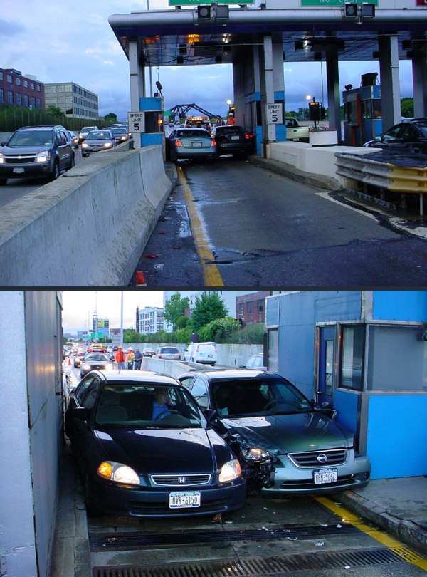

Slide 14
“The Evangelical Option”
Ditch of Accommodation
Ditch of Isolation
Biblical Balance
Relevant, but not biblical
Biblical, but not relevant
“…obscurantist, angry, and separatist fundamentalism…”
“… revisionist compromise…”
Emergent Postmodernism
Separatist Fundamentalism

Slide 15
Balance
Internal
External

Slide 16
Missional Sunday School
Internal Focus vs. External Focus
  Equipping
  Formation
  Encouragement
  Accountability

Slide 17
Missional Sunday School
Internal Focus vs. External Focus
  Formation
  Encouragement
  Equipping
  Accountability
Ministry with neighbors
Among the nations

Slide 18
Balance

Slide 19
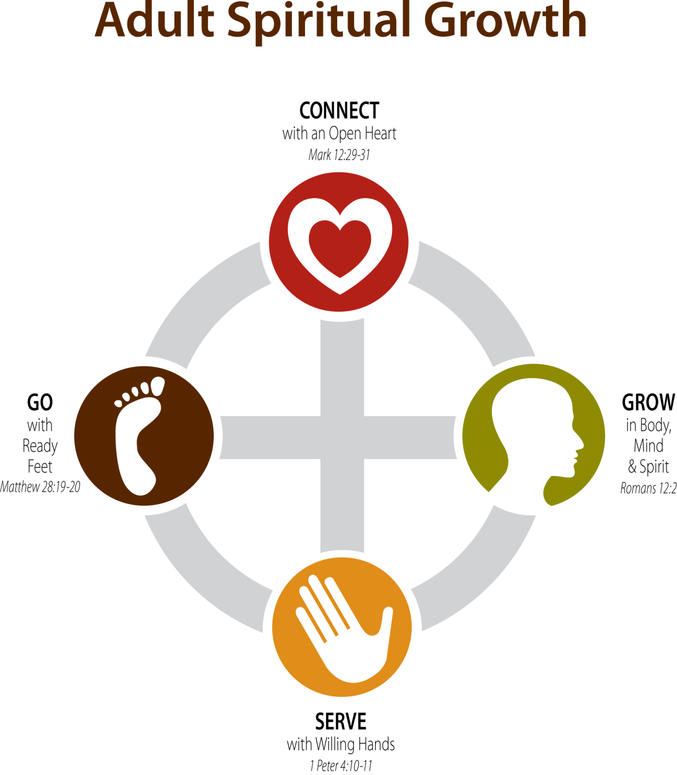


Slide 20
CONNECT with God and Others – Fellowship
GROW in Christ Through His Word – Discipleship
SERVE Church and Community – Ministry
GO tell others about Jesus -Evangelism

Slide 21
All Sunday School groups should be involved in all four areas:
CONNECT
GROW
SERVE
GO
RIGHT?

Slide 22
CONNECT
GROW
SERVE
GO

Slide 23
Reality
Depending upon the PURPOSE of the group…one is usually dominant

Slide 24
Discipleship
Fellowship
Grow
Connect
Connect
Serve
Grow
Serve
Go
Go
Ministry
Evangelism
Serve
Go
Connect
Grow
Connect
Serve
Go
Grow

Slide 25
Missional Sunday School
A missional Sunday School…
A reproducing community of authentic disciples being equipped as missionaries sent by God to live and proclaim His Word in their world.

Slide 26
Missional Sunday School
Integrated Components of a Missional Posture:
Concept of our Collective Purpose
Our Culture
Our Capacity
Content of the Gospel

Slide 27
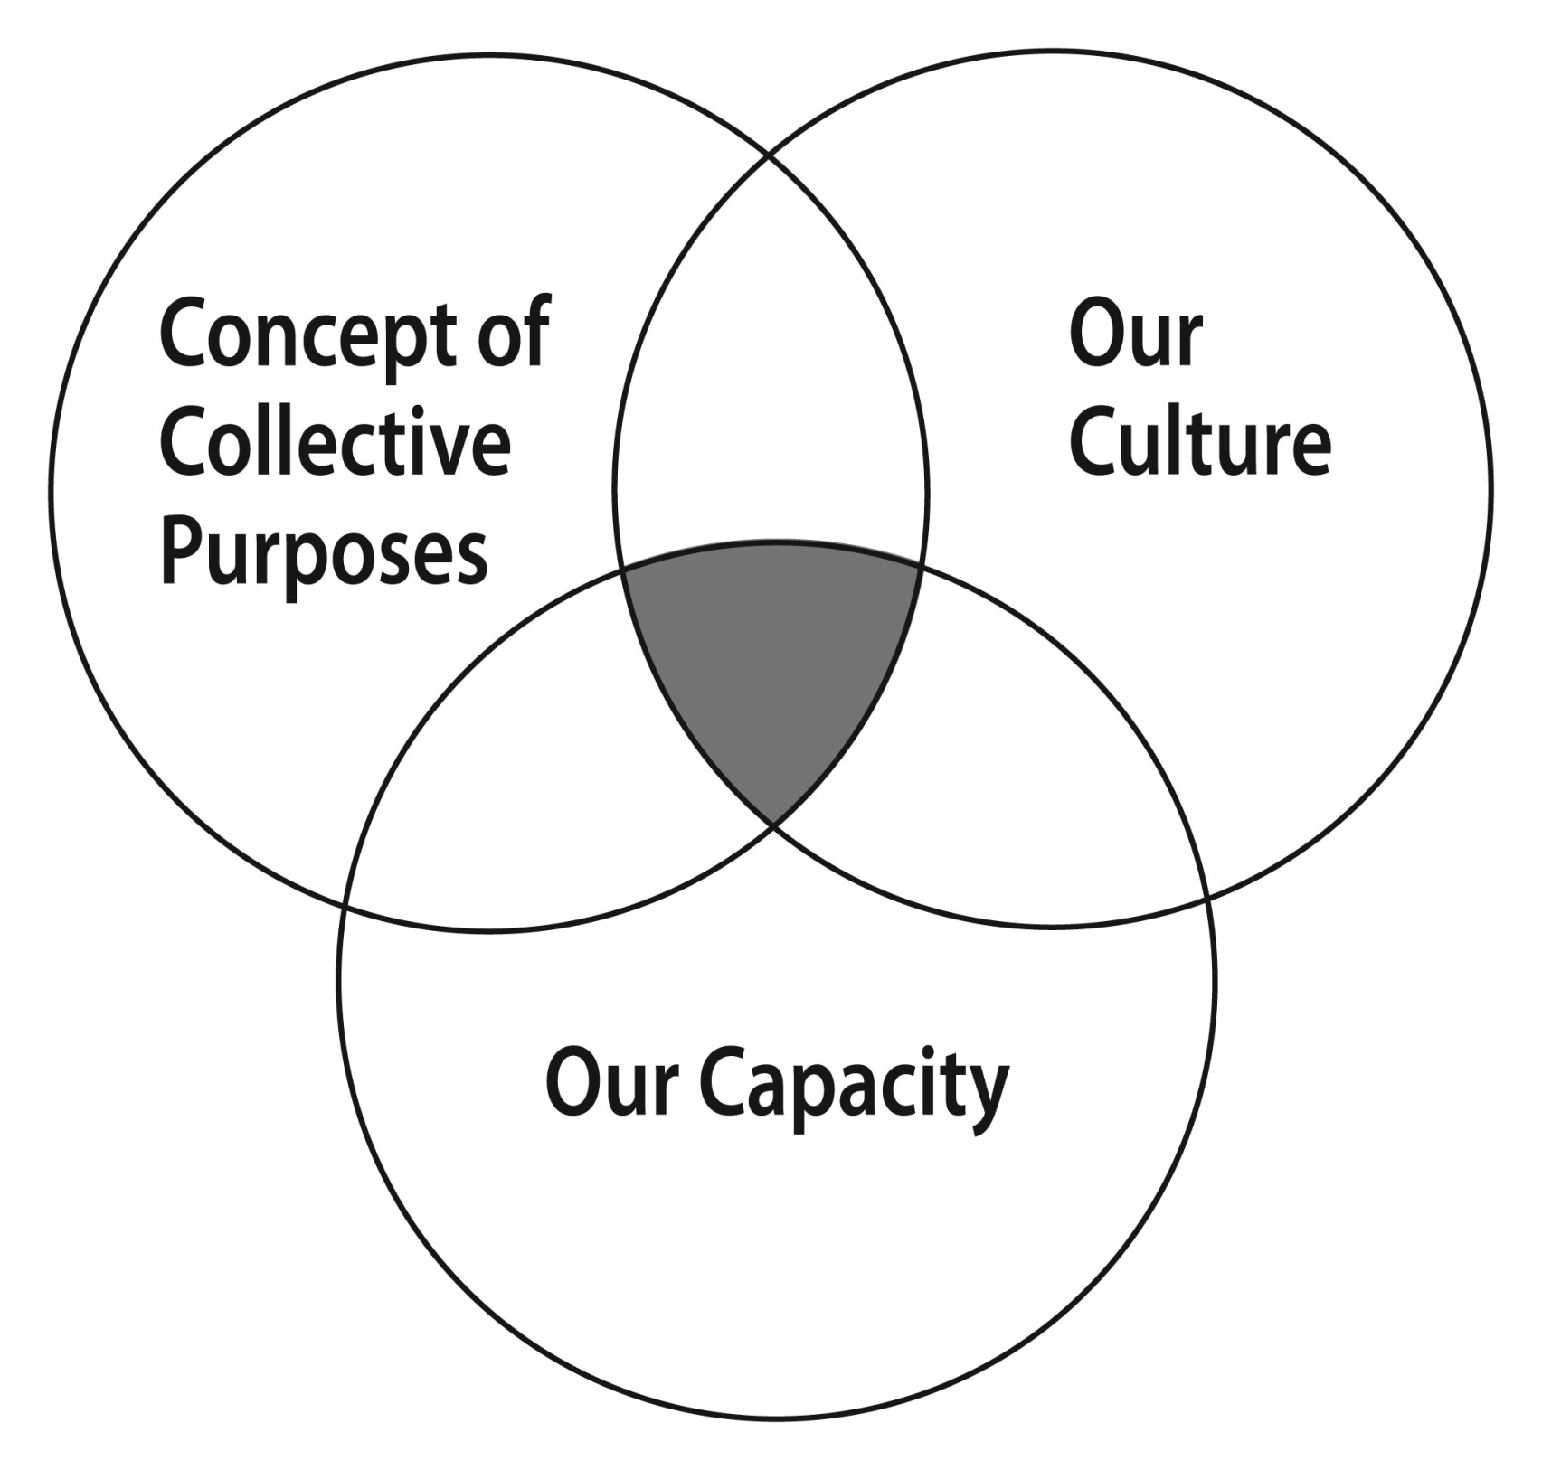

Slide 28
Missional Sunday School
Content of the Gospel
Teach the Bible
Have a systematic approach to Bible study
Foundational

Slide 29
Missional Sunday School
Individual
Group Bible Study
A missional Sunday School…
A reproducing community of authentic disciples being equipped as missionaries sent by God to live and proclaim His Word in their world.
Daily Godly Lifestyle
Corporate
Class Missions

Slide 30
Those who are most successful in the last paradigm often have the most difficulty moving ahead in the next.
11 Innovations in the Local Church
Elmer Towns Ed Stetzer Warren Bird

Slide 31

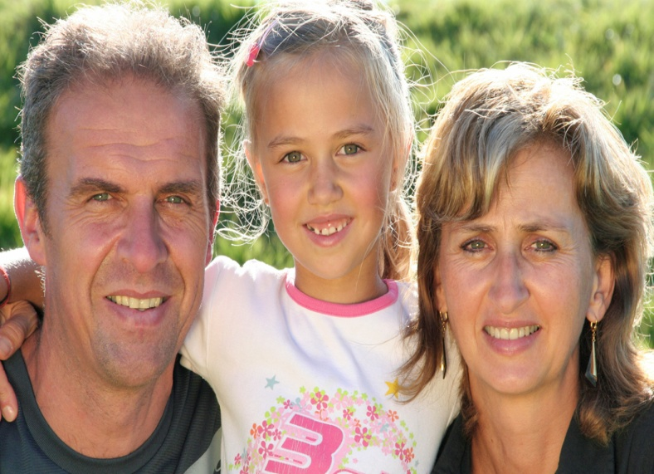
What do we want to produce?

Slide 32
Balance
Missional Sunday School
Ministry
Missions
Sunday School
Worship
LOST WORLD

